Slide 1
Using Bayesian Optimization in Pose Graphs Based SLAM 29th May
Zuxun Wang

Slide 2
Progress Since Last Meeting
Try with 1D/2D process model with MATLAB
1D Static
2D Dynamic
Explore using example code for workshop topic2-part2
Might work with Bruce to test with ground truth case
Test without ground truth
Find useful materials e.g., papers, or videos

Slide 3
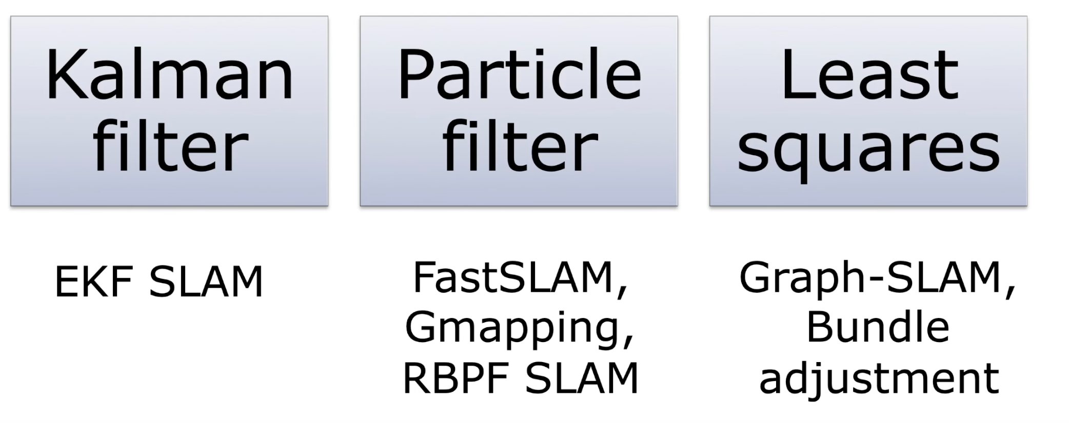
Three Traditional Paradigms of SLAM
Source: https://www.youtube.com/watch?v=Alu59K8zvYs

Slide 4
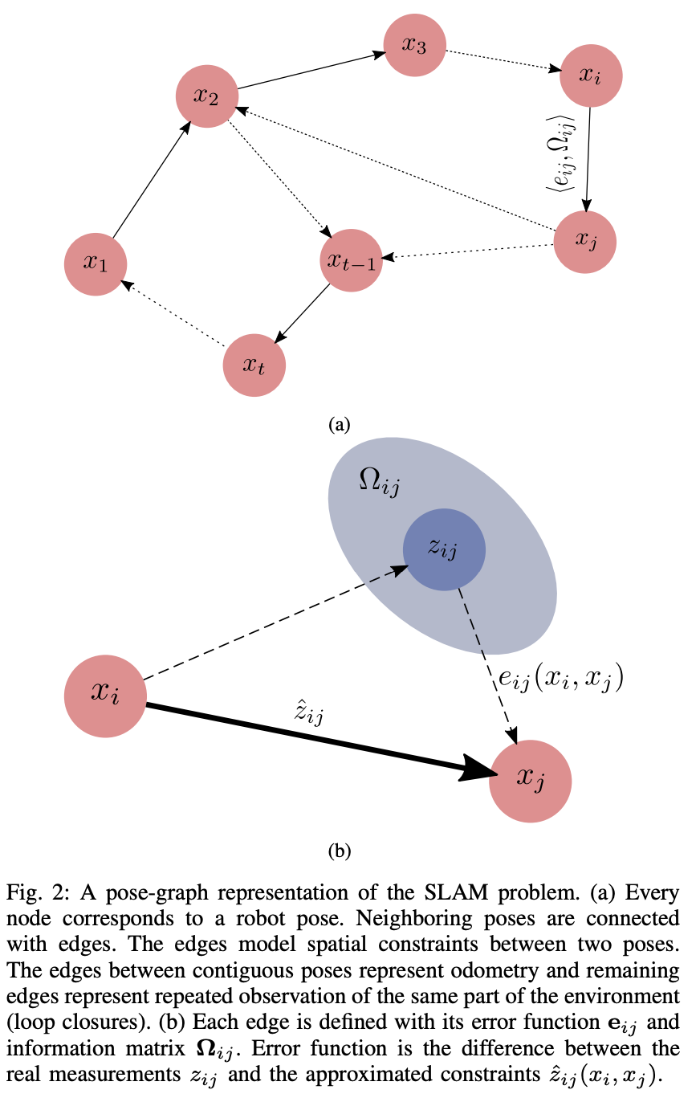
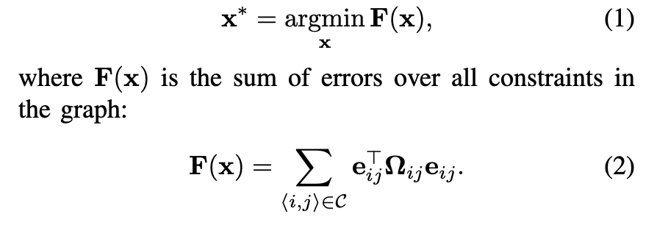
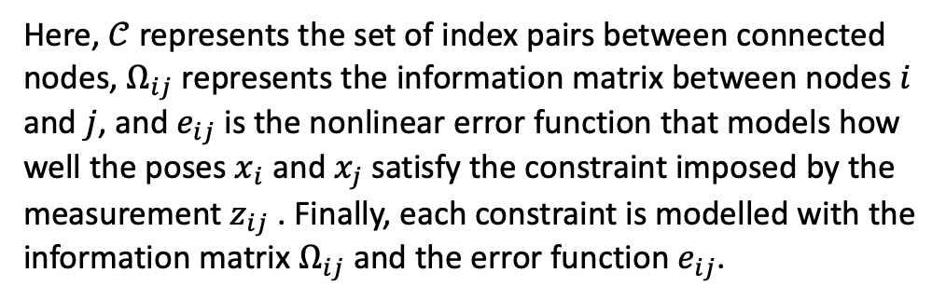
Nonlinear Least Squares Optimisation
In general, a nonlinear least squares optimization problem can be defined as follows:
Here, $𝒞$ represents the set of index pairs between connected nodes, $Ω_{ij}$ represents the information matrix between nodes $i$ and $j$, and $e_{ij}$ is the nonlinear error function that models how well the poses $x_{i}$ and $x_{j}$ satisfy the constraint imposed by the measurement $z_{ij}$ . Finally, each constraint is modelled with the information matrix $Ω_{ij}$ and the error function $e_{ij}$.

Slide 5

Problems / Issues
In 1d static model, we set the initial estimate to be z(1), so that the it won’t be far from the final solution.
In 2d tracking model, we set the initial estimate of each vertex to be zeros.
Is there any better initial estimate? Why should we use

Slide 6
Related Works
“Referring to Simon’s paper (in-progress paper) for inspiration?”

Slide 7
Planned Activities
Actual property of F(x)
Characteristics of chi2 model
Linear model -> multiple omega, checking x
StaticModel -> run multiple times, average chi2Store

